Slide 1
Taiwan 2008 CUDA Course
Programming Massively Parallel Processors: the CUDA experience
Lecture 4:
CUDA Threads
© David Kirk/NVIDIA and Wen-mei W. Hwu
Taiwan, June 30-July 2, 2008

Slide 2
Block IDs and Thread IDs
Each thread uses IDs to decide what data to work on
  Block ID: 1D or 2D
  Thread ID: 1D, 2D, or 3D
Simplifies memory
addressing when processing
multidimensional data
  Image processing
  Solving PDEs on volumes
  …
Device
Grid 1
Block
(0, 0)
Block
(1, 0)
Block
(2, 0)
Block
(0, 1)
Block
(1, 1)
Block
(2, 1)
Block (1, 1)
Thread
(0, 0)
Thread
(1, 0)
Thread
(2, 0)
Thread
(3, 0)
Thread
(4, 0)
Thread
(0, 1)
Thread
(1, 1)
Thread
(2, 1)
Thread
(3, 1)
Thread
(4, 1)
Thread
(0, 2)
Thread
(1, 2)
Thread
(2, 2)
Thread
(3, 2)
Thread
(4, 2)
© David Kirk/NVIDIA and Wen-mei W. Hwu
Taiwan, June 30-July 2, 2008
Courtesy: NDVIA

Slide 3
CUDA Thread Block: Review
All threads in a block execute the same kernel program (SPMD)
Programmer declares block:
  Block size 1 to 512 concurrent threads
  Block shape 1D, 2D, or 3D
  Block dimensions in threads
Threads have thread id numbers within block
  Thread program uses thread id to select work and address shared data
Threads in the same block share data and synchronize while doing their share of the work
Threads in different blocks cannot cooperate
  Each block can execute in any order relative to other blocs!
CUDA Thread Block
Thread Id #:
0 1 2 3 … m
Thread program
Courtesy: John Nickolls, NVIDIA
© David Kirk/NVIDIA and Wen-mei W. Hwu
Taiwan, June 30-July 2, 2008

Slide 4
Transparent Scalability
Hardware is free to assigns blocks to any processor at any time
  A kernel scales across any number of parallel processors
Device
Kernel grid
Block 0
Block 1
Device
Block 2
Block 3
Block 0
Block 1
Block 4
Block 5
Block 6
Block 7
time
Block 0
Block 1
Block 2
Block 3
Block 2
Block 3
Block 4
Block 5
Block 6
Block 7
Block 4
Block 5
Each block can execute in any order relative to other blocks.
Block 6
Block 7
© David Kirk/NVIDIA and Wen-mei W. Hwu
Taiwan, June 30-July 2, 2008

Slide 5
G80 Example: Executing Thread Blocks
SM 0
SM 1
t0 t1 t2 … tm
t0 t1 t2 … tm
MT IU
MT IU
Blocks
SP
SP
Threads are assigned to Streaming Multiprocessors in block granularity
  Up to 8 blocks to each SM as resource allows
  SM in G80 can take up to 768 threads
    Could be 256 (threads/block) * 3 blocks
    Or 128 (threads/block) * 6 blocks, etc.
Threads run concurrently
  SM maintains thread/block id #s
  SM manages/schedules thread execution
Blocks
Shared
Memory
Shared
Memory
© David Kirk/NVIDIA and Wen-mei W. Hwu
Taiwan, June 30-July 2, 2008

Slide 6
G80 Example: Thread Scheduling
Each Block is executed as 32-thread Warps
  An implementation decision, not part of the CUDA programming model
Warps are scheduling units in SM
If 3 blocks are assigned to an SM and each block has 256 threads, how many Warps are there in an SM?
  Each Block is divided into 256/32 = 8 Warps
  There are 8 * 3 = 24 Warps
  At any point in time, only one of the 24 Warps will be selected for instruction fetch and execution.
…
Block 1 Warps
…
Block 2 Warps
…
…
t0 t1 t2 … t31
t0 t1 t2 … t31
Streaming Multiprocessor
Instruction L1
Instruction Fetch/Dispatch
Shared Memory
SP
SP
SP
SP
SFU
SFU
SP
SP
SP
SP
© David Kirk/NVIDIA and Wen-mei W. Hwu
Taiwan, June 30-July 2, 2008

Slide 7
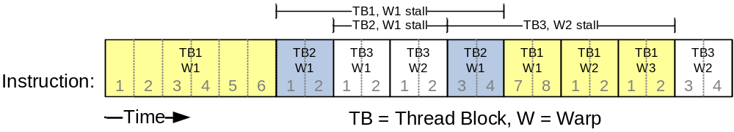
G80 Example: Thread Scheduling (Cont.)
SM hardware implements zero-overhead Warp scheduling
  Warps whose next instruction has its operands ready for consumption are eligible for execution
  Eligible Warps are selected for execution on a prioritized scheduling policy
  All threads in a Warp execute the same instruction when selected
4 clock cycles needed to dispatch the same instruction for all threads in a Warp in G80
  If one global memory access is needed for every n instructions
  A minimum of 200/4n Warps are needed to fully tolerate 200-cycle memory latency
© David Kirk/NVIDIA and Wen-mei W. Hwu
Taiwan, June 30-July 2, 2008

Slide 8
G80 Tiling Granularity Considerations
For Matrix Multiplication, should I use 8X8, 16X16 or 32X32 tiles?
  For 8X8, we have 64 threads per Block. Since each SM can take up to 768 threads, it can take up to 12 Blocks. However, each SM can only take up to 8 Blocks, only 512 threads will go into each SM!
  For 16X16, we have 256 threads per Block. Since each SM can take up to 768 threads, it can take up to 3 Blocks and achieve full capacity unless other resource considerations overrule.
  For 32X32, we have 1024 threads per Block. Not even one can fit into an SM!
© David Kirk/NVIDIA and Wen-mei W. Hwu
Taiwan, June 30-July 2, 2008

Slide 9
G80 Shared Memory and Threading
Each SM in G80 has 16KB shared memory
  Dynamic Resource: Blocks under the same SM share the 16KB, but different Blocks can’t read data of others.
  SM size is implementation dependent!
  For TILE_WIDTH = 16, each thread block uses 2*256*4B = 2KB of shared memory.
  Can potentially have up to 8 Thread Blocks actively executing
    This allows up to 8*512 = 4,096 pending loads. (2 per thread, 256 threads per block)
  The next TILE_WIDTH 32 would lead to 2*32*32*4B= 8KB shared memory usage per thread block, allowing only up to two thread blocks active at the same time
© David Kirk/NVIDIA and Wen-mei W. Hwu
Taiwan, June 30-July 2, 2008

Slide 10
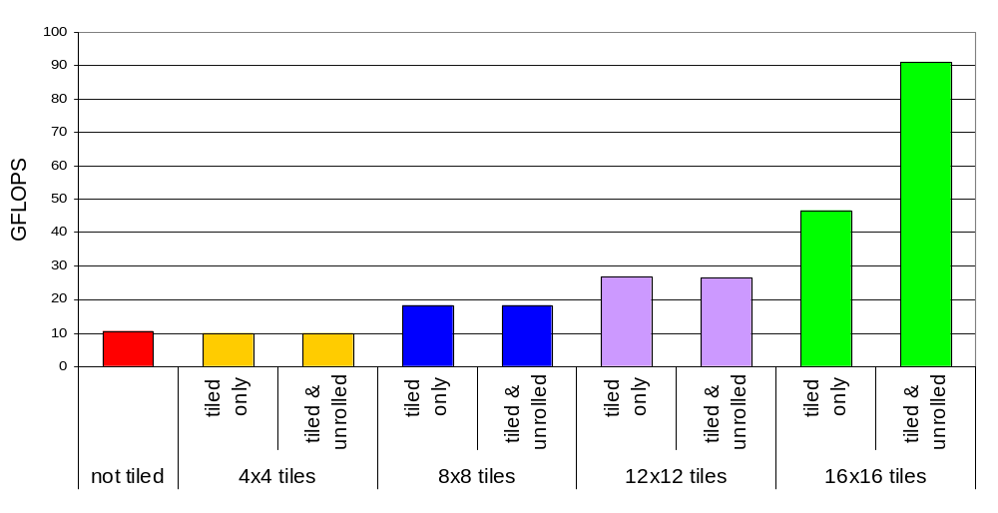
Tiling Size Effects
© David Kirk/NVIDIA and Wen-mei W. Hwu
Taiwan, June 30-July 2, 2008
Notes:
Mention that we’re limited from large tile sizes by thread context maximums.

Slide 11
Some Additional API Features
© David Kirk/NVIDIA and Wen-mei W. Hwu
Taiwan, June 30-July 2, 2008

Slide 12
Application Programming Interface
The API is an extension to the C programming language
It consists of:
  Language extensions
    To target portions of the code for execution on the device
  A runtime library split into:
    A common component providing built-in vector types and a subset of the C runtime library in both host and device codes
    A host component to control and access one or more devices from the host
    A device component providing device-specific functions
© David Kirk/NVIDIA and Wen-mei W. Hwu
Taiwan, June 30-July 2, 2008

Slide 13
Language Extensions:
Built-in Variables
dim3 gridDim;
  Dimensions of the grid in blocks (gridDim.z unused)
dim3 blockDim;
  Dimensions of the block in threads
dim3 blockIdx;
  Block index within the grid
dim3 threadIdx;
  Thread index within the block
© David Kirk/NVIDIA and Wen-mei W. Hwu
Taiwan, June 30-July 2, 2008

Slide 14
Common Runtime Component:
Mathematical Functions
pow, sqrt, cbrt, hypot
exp, exp2, expm1
log, log2, log10, log1p
sin, cos, tan, asin, acos, atan, atan2
sinh, cosh, tanh, asinh, acosh, atanh
ceil, floor, trunc, round
Etc.
  When executed on the host, a given function uses the C runtime implementation if available
  These functions are only supported for scalar types, not vector types
© David Kirk/NVIDIA and Wen-mei W. Hwu
Taiwan, June 30-July 2, 2008

Slide 15
Device Runtime Component:
Mathematical Functions
Some mathematical functions (e.g. sin(x)) have a less accurate, but faster device-only version (e.g. __sin(x))
  __pow
  __log, __log2, __log10
  __exp
  __sin, __cos, __tan
© David Kirk/NVIDIA and Wen-mei W. Hwu
Taiwan, June 30-July 2, 2008

Slide 16
Host Runtime Component
Provides functions to deal with:
  Device management (including multi-device systems)
  Memory management
  Error handling
Initializes the first time a runtime function is called
A host thread can invoke device code on only one device
  Multiple host threads required to run on multiple devices
© David Kirk/NVIDIA and Wen-mei W. Hwu
Taiwan, June 30-July 2, 2008

Slide 17
Device Runtime Component:
Synchronization Function
void __syncthreads();
Synchronizes all threads in a block
Once all threads have reached this point, execution resumes normally
Used to avoid RAW / WAR / WAW hazards when accessing shared or global memory
Allowed in conditional constructs only if the conditional is uniform across the entire thread block
© David Kirk/NVIDIA and Wen-mei W. Hwu
Taiwan, June 30-July 2, 2008
Notes:
Atomic Operations?

